Slide 1


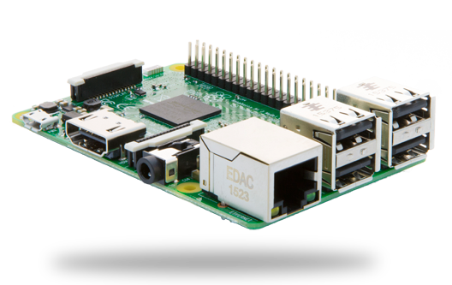
RASPBERRY PI
Presented By:
Ashish Porwal (16MTES03)
Murtaza Ameen (16MTES09)
Under Guidance Of:
Dr. Manju K Chattopadhyay

Slide 2
Contents:
Introduction to Raspberry Pi.
Communication protocols.
First Time Setup.
Webpage Development.
Introduction to MySQL.
Server and Client application of RPi.
Server Based Robot Using RPi and Android app.
Conclusion

Slide 3
Introduction:
Lets start Raspberry Pi as just Pi to save some real estate ☺
“Pi is a single board computer”.
Pi is small scale computer in size little bigger than a credit card.
Developed in United Kingdom by Raspberry Pi foundation.
Pi was introduced as an educational gadget for those who want to learn programing.
Pi is based on Broadcom SoC (System on Chip) with an ARM processor.
Consists a GPU and 1 GB of RAM.
The boot media is a SD card and can also be used for persist data.
Pi can be used as a cheap computer for experiments and education purposes.
Cost of Pi is around Rs. 3000 for a B model.
[1]

Slide 4
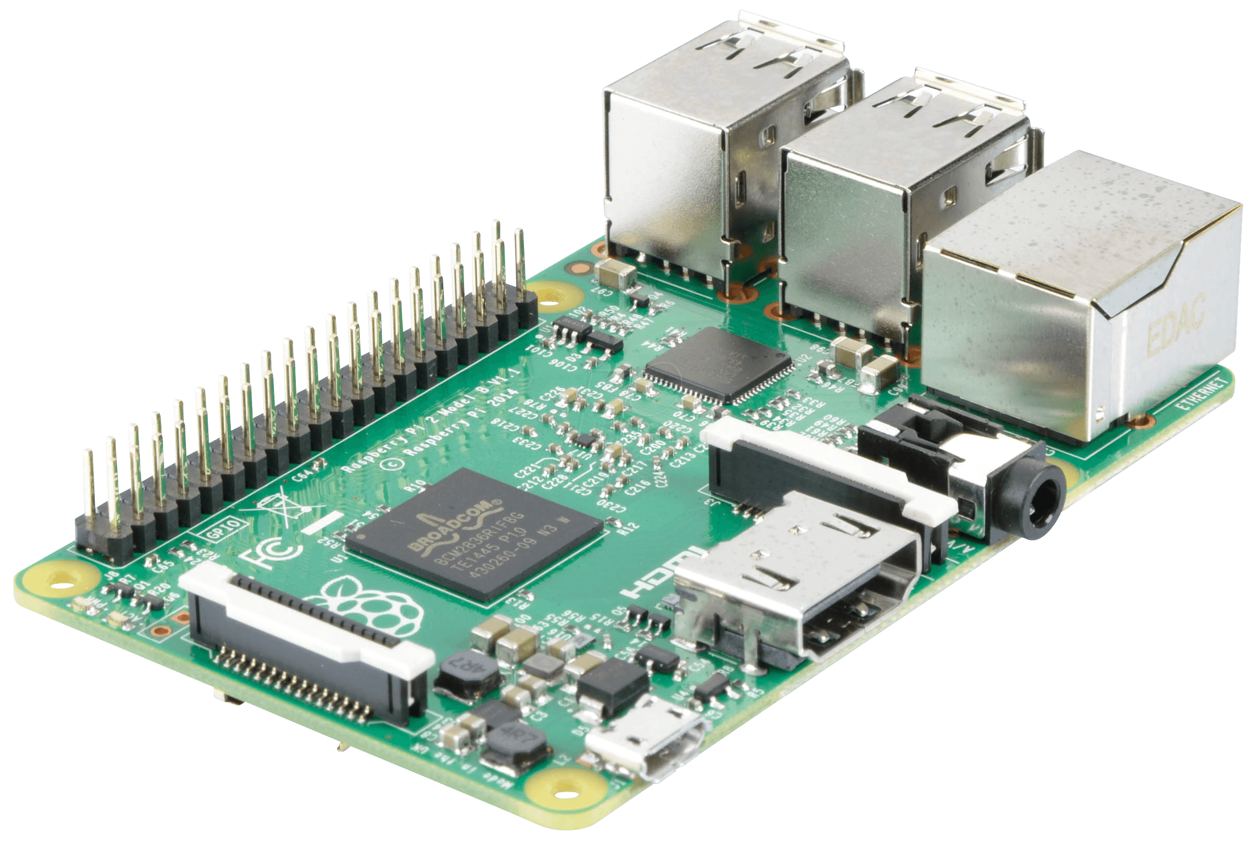
Dimension
85.6mm x 56mm x 21mm
LAN controller
4 USB 2 ports
10/100
LAN port
Broadcom BCM2837 64bit
Quad core CPU at 1.2GHz
1GB RAM
GPIO pins
3.5mm audio jack
CSI camera port
On board
Bluetooth
Wifi
Full size HDMI video port
SD card slot
DSI display port
Micro usb power input

Slide 5
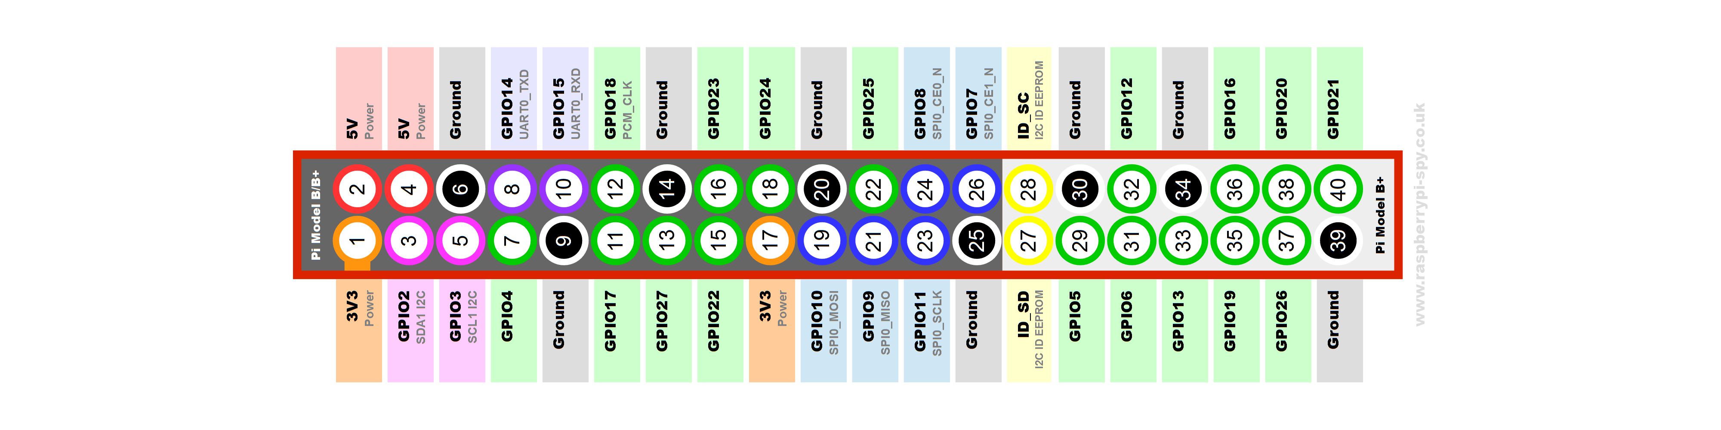
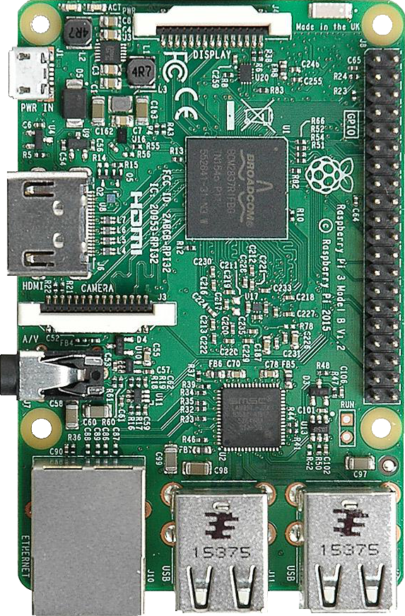
GPIO pins
Pin Configuration
2- 5v power supply pins.
2- 3.3v power supply pins.
8- Ground pins.
17- General I/O pins.
2- I2C interface pins.
5- SPI interface pins.
2- UART pins.
2- ID EEPROM interface pin.

Slide 6
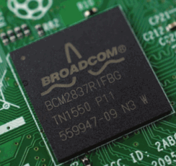
Processor
1.2GHz
64-bit
quad-core
ARMv7 CPU
1GB RAM

Slide 7
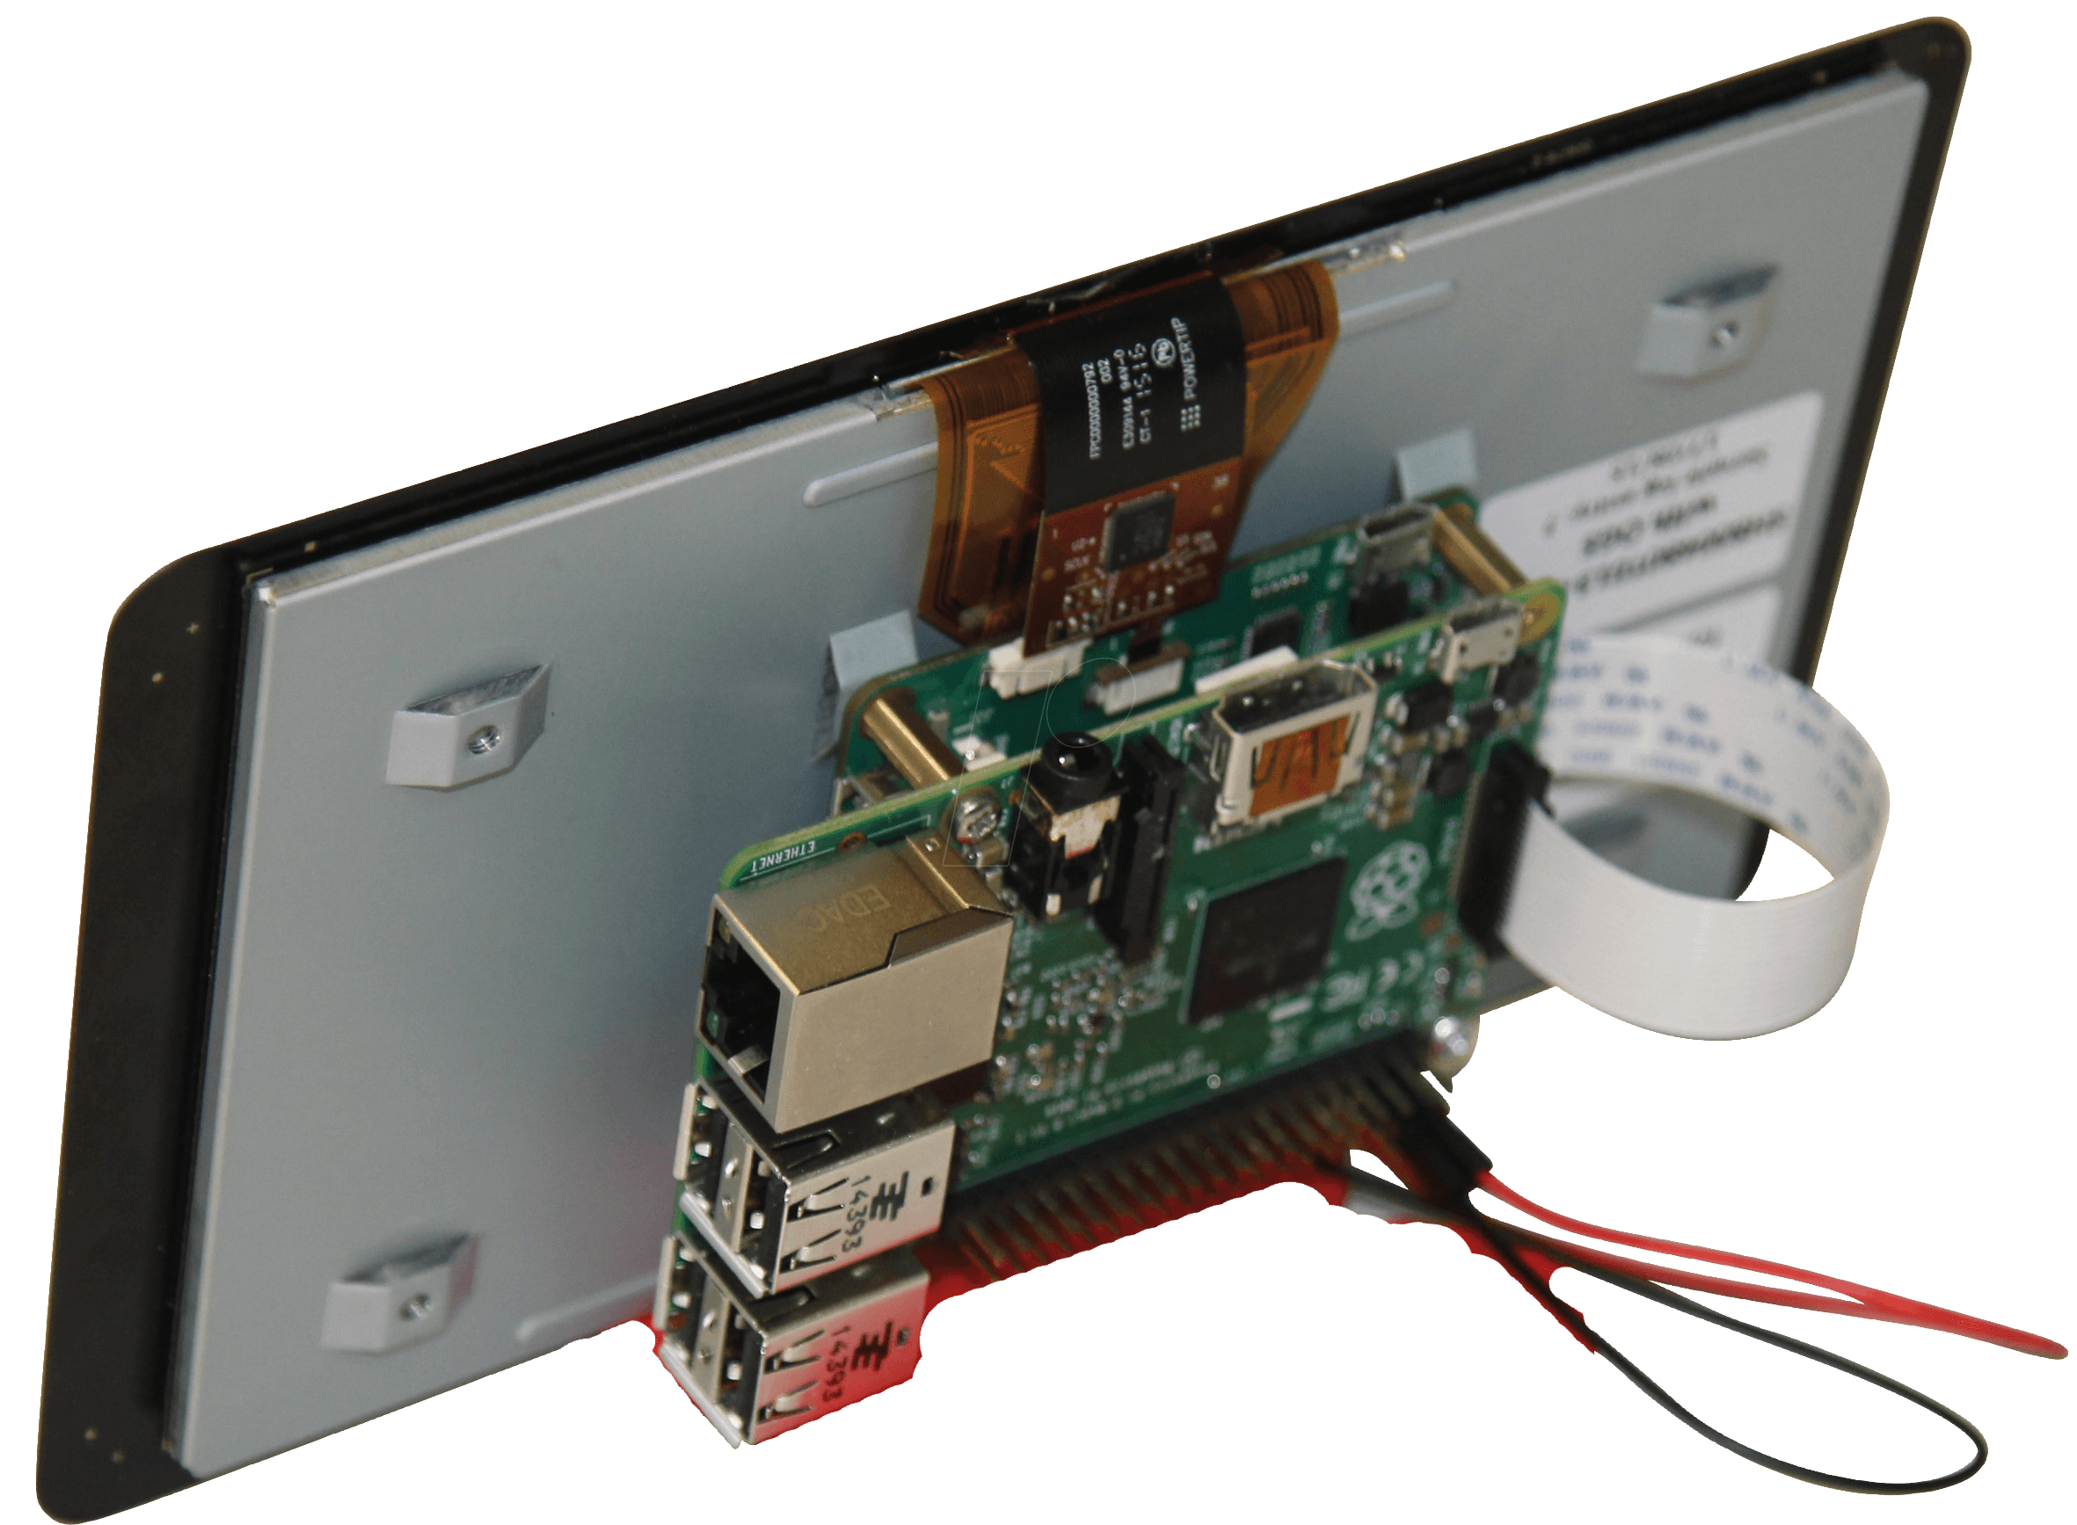
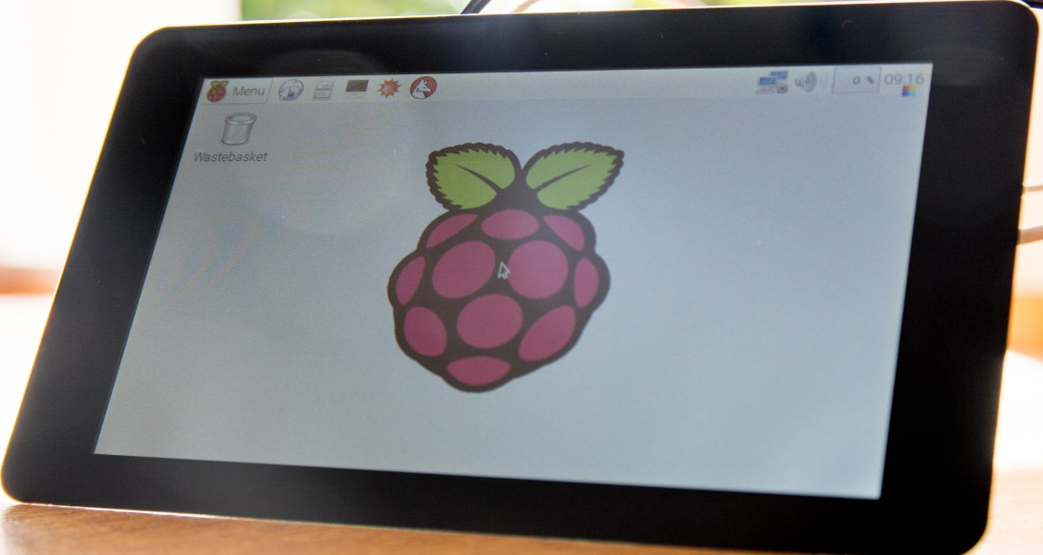
DSI (display serial interface)
port

Slide 8
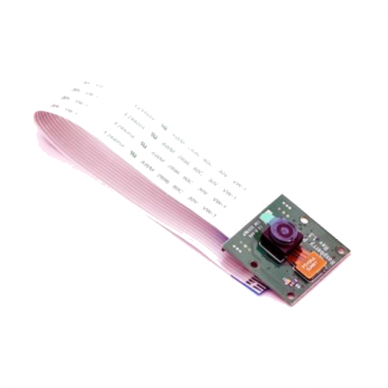
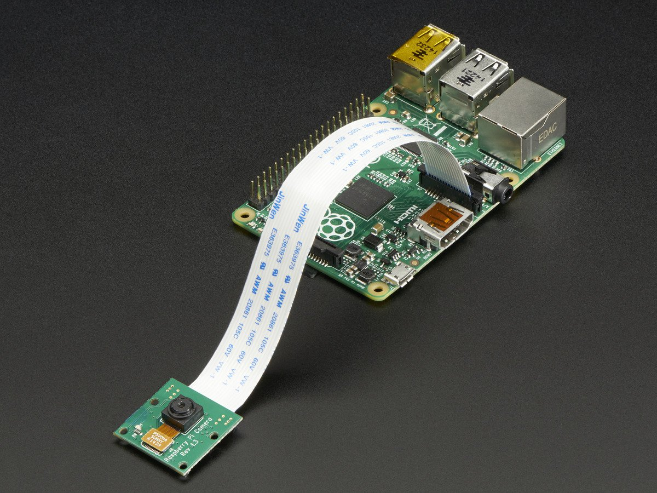
CSI (camera serial interface)
Port
Small board size: 25mm x 20mm x 9mm.
5MP (2592×1944 pixels) Omni vision 5647 sensor in a fixed focus module.
Support 1080p30, 720p60 and 640x480p60/90 video record.

Slide 9
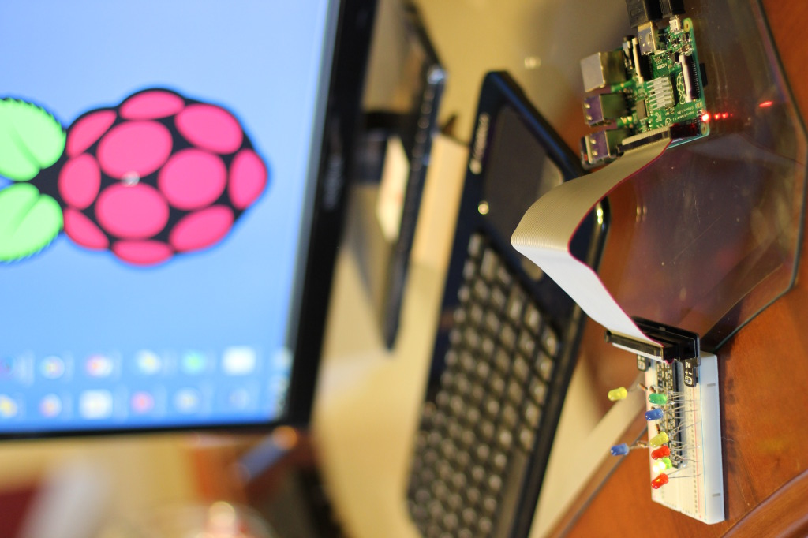
HDMI Port
HDMI port is used to connect pi with TV or other HDMI supported devices.
Audio and video both are supported through HDMI port.

Slide 10
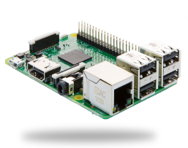
SPI Protocol:
SCLK
MOSI
MISO
SS1
SS2
SS3
SCLK
MOSI
MISO
SS
SPI
SLAVE 1
SPI
MASTER
SCLK
MOSI
MISO
SS
SPI
SLAVE 2
SCLK
MOSI
MISO
SS
SPI
SLAVE 3

Slide 11
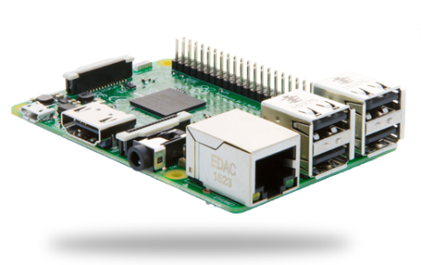
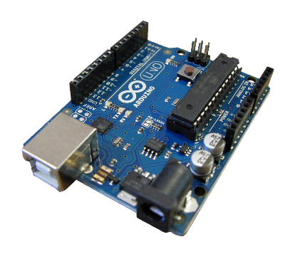
I2C Protocol:
SCL SDA
SCL SDA
SCL SDA
Master
Slave 1
Slave 2

Slide 12
First Time Setup

Slide 13
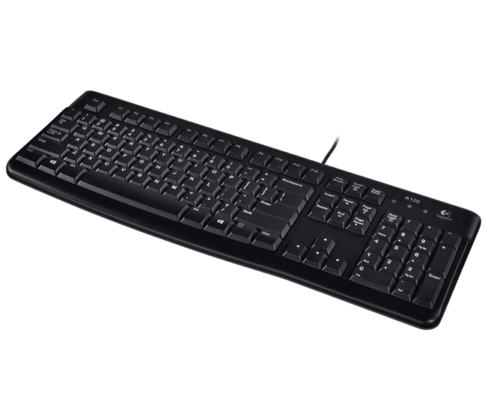
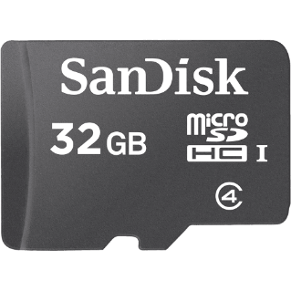
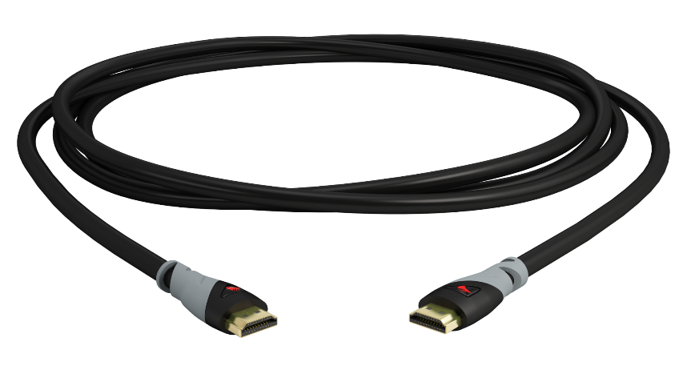
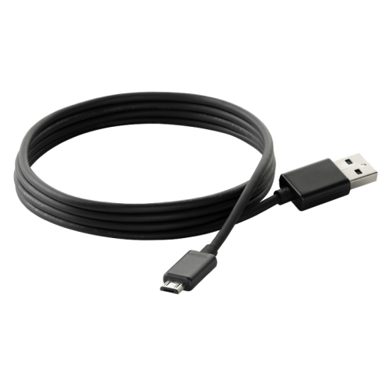
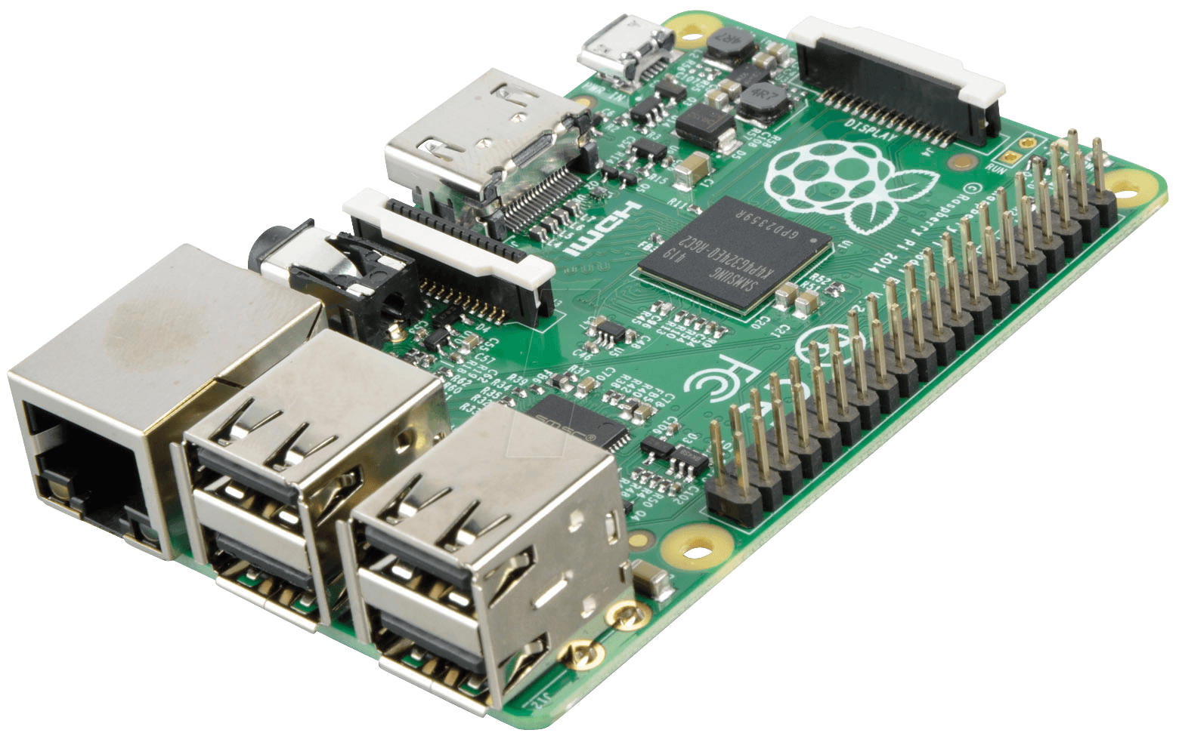
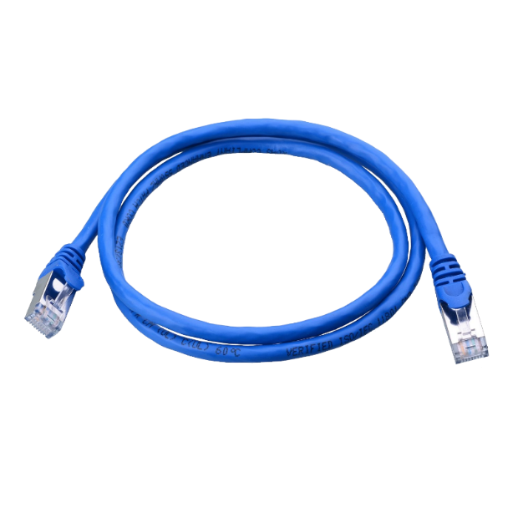
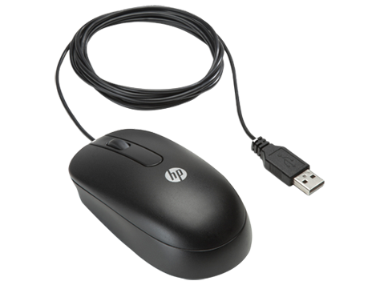

Requirements:
Sd card
HDMI cable
USB keyboard
Micro USB
USB Mouse
LAN cable
Display Device
Raspberry Pi

Slide 14
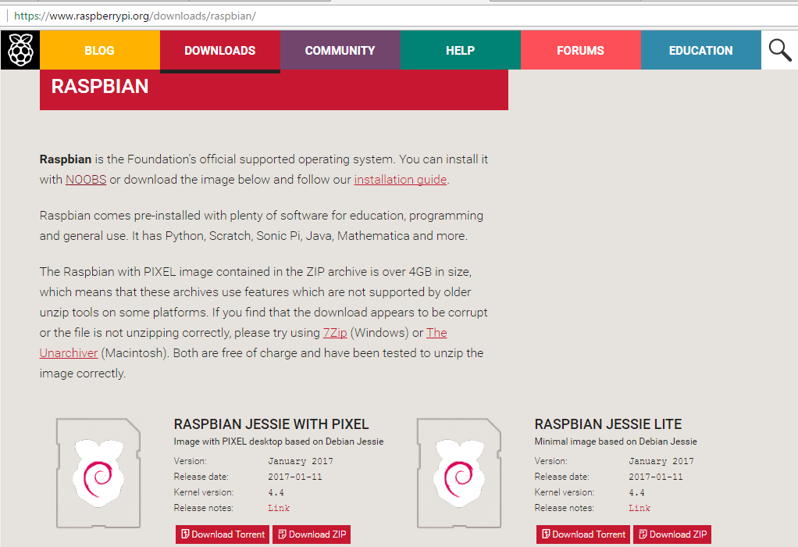
Download Raspbian OS:
Open www.raspberrypi.org.
Go to ‘Downloads’ section.
Click on ‘Raspbian’.
Then click ‘Download ZIP’ of
‘RASPBIAN JESSIE WITH PIXEL’
Direct Link for Downloading
Zip file https://downloads.raspberrypi.org/raspbian_latest
It requires 1.5 Gb size in your
computer.
Now extract image file from
Zip file.
The extracted file is about of
size more than 4 Gb.

Slide 15
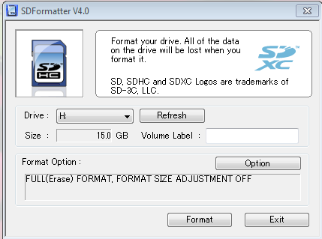
Format SD card
Insert micro sd card in computer.
Open SDFormatter software.
Select Full Erase from option menu.
Click on Format button.
Download Link of SDFormatter for windows:
https://www.sdcard.org/downloads/formatter_4/eula_windows/SDFormatterv4.zip

Slide 16
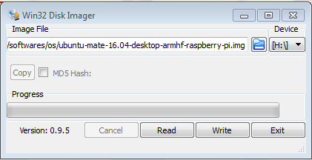
Install Raspbian OS on micro SD card:
Open Win32DiskImager software
Provide the path of Raspbian Image file
which you already downloaded
Click on ‘Write’ button.
It takes around 10 minutes to install OS.
Now your SD card is ready with Raspbian
OS Loaded in it.

Slide 17
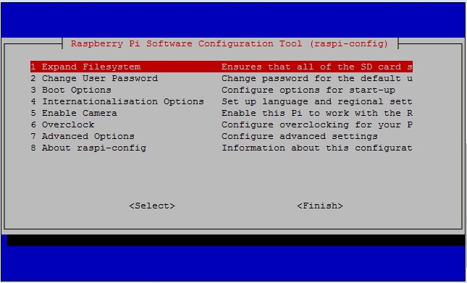
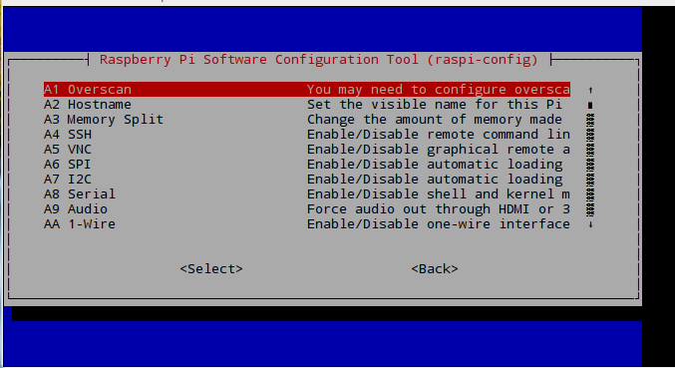
Let us Start with Pi:
Insert SD card inside your Raspberry pi.
Plug mouse and key board.
Connect RPi with HDMI supported TV or Monitor
Provide 5v power to RPi using micro USB.
Open the RPi terminal and write the command:
Sudo raspi-config
Select option 7 (Advanced Options)
Then select SSH and enable it.

Slide 18
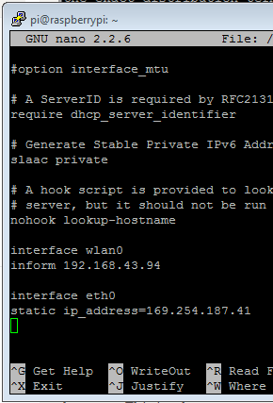
Provide static IP to RPi:
Open the terminal.
Write command sudo nano /etc/dhcpcd.conf
At the end of file write:
Interface wlan0
Inform 192.168.43.94
Interface eth0
Static ip_address=169.254.187.41
Note: Do not alter the content of the file.

Slide 19
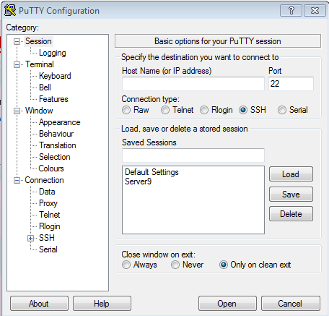
Install putty in windows:
For running your RPi terminal on windows download putty software.
https://the.earth.li/~sgtatham/putty/latest/x86/putty-0.67-installer.msi
Open the Putty.
write the static IP address of RPi in host name edit text.
Then click on open.
Now you are able to run RPi terminal on your personal computer.
Note: If you are connecting RPi using Ethernet cable then write IP address of eth0, else the IP of wlan0 which provided in dhcpcd.conf file.

Slide 20
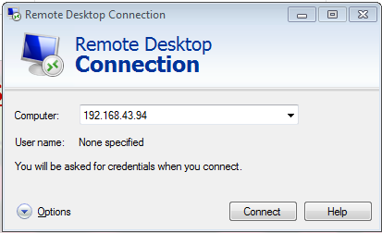
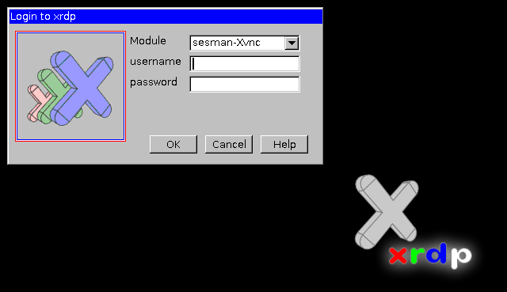
Remote Desktop Setup:
Write the command on RPi
sudo apt-get install xrdp
Open remote desktop type IP address of RPi then click on connect.
New window will pop up which asks for username and password.
Default username and password is:
Username- pi
password- raspberry
Now the desktop of RPi is visible in that window, and You can use your key board mouse of your computer for accessing RPi without physically connecting them.

Slide 21
Commands for installing important libraries:
Open terminal and write following commands.
Sudo apt-get update
Sudo apt-get install motion
sudo apt-get install apache2
sudo apt-get install php5 libapache2-mod-php5
sudo apt-get install apache2 php5 php5-mysql mysql-server
Sudo apt-get install python3-rpi.gpio

Slide 22
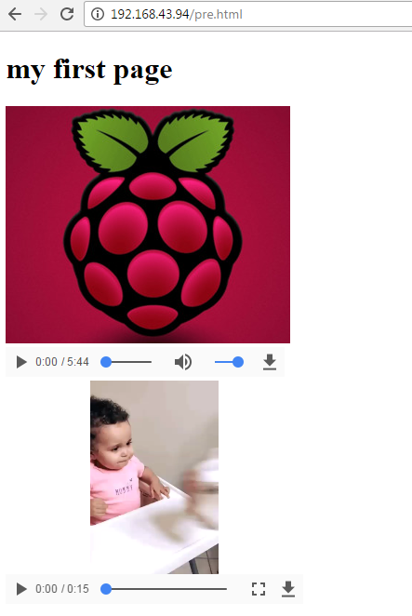
Developing First webpage:
HTML code:
<!DOCTYPE html>
<html>
<title>SOEX</title>
<body>
<h1>my first page</h1>
<image src=“aaa.jpg”>
<video width="320" height="240" controls> <source src="movie.mp4" type="video/mp4"> not supported. </video>
<audio controls> <source src=“abhiabhi.mp3" type="audio/mp3"> not supported. </audio>
</body>
</html>

Slide 23
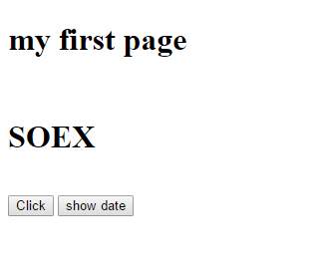
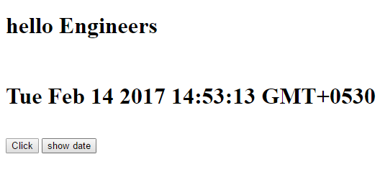
Webpage with javascript:
<!DOCTYPE html>
<html>
<title>SOEX</title>
<body>
<h1 id=“head”>my first page</h1><br>
<h1 id=“head2”>SOEX</h1><br>
<button type=“button” onclick=“changeHeading()”>Click</button>
<button type=“button” onclick=“document.getElementById(“head2”).innerHTML=Date();
”>Click</button>
<script>
function changeHeading(){
document.getElementById(“head”).innerHTML=“hello Engineers”;
}
</script>
</body>
</html>

Slide 24
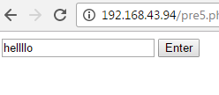
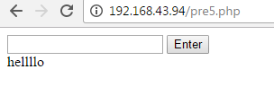
Webpage with PHP
<!DOCTYPE html>
<html>
<body>
<form action="" method="POST">
<input type=“text” name=”text”>
<input type="submit" name="form_submit" value=“Enter">
</form>
</body>
</html>
<?php
if(isset($_POST['form_submit']))
{
echo $_POST[‘text’];
}?>

Slide 25
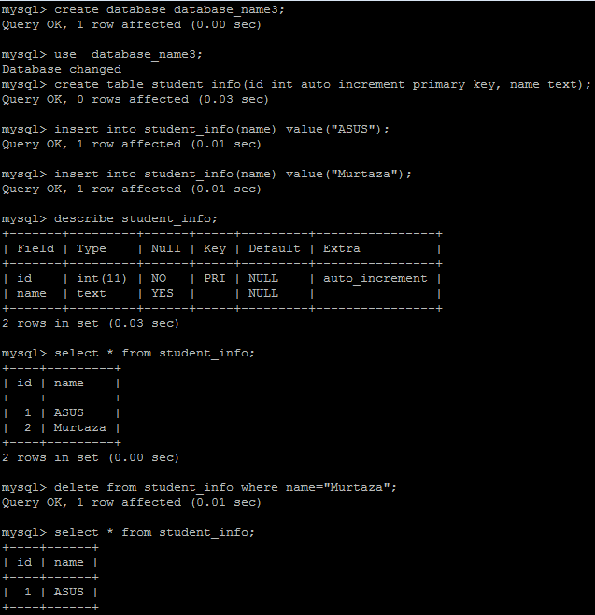
Introduction to MySQL:
Enter the commands.
mysql –u root -p
Enter MySQL password.
Create database database_name ;
use database_name ;
create table student_info (id int auto_increment primary key, name text) ;
describe student_info ;
insert into student_info (name) value (“Ashish”) ;
insert into student_info (name) value (“Murtaza”) ;
Select * from student_info ;
Delete from student_info where name=“Murtaza” ;

Slide 26
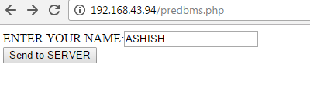
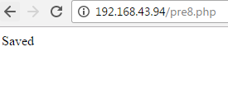
Webpage using MySQL:
<?php
$name=$_POST["name"];
$dbms=new mysqli("localhost","root","123","database_name3");
if($dbms->connect_error){
die("Connection Failed!").$dbms->connect_error;
}
else{
if($dbms->query('INSERT INTO student_info(name) value ("$name");')){
echo "Saved";
}
else{
echo "not saved";
}}
?>
<!DOCTYPE html>
<html>
<body>
<form method="POST" action="pre8.php">
ENTER YOUR NAME:<input type="text" name="name">
<br>
<input type="submit" value="Send to SERVER">
</form>
</body>
</html>

Slide 27
SERVER and CLIENT Application

Slide 28
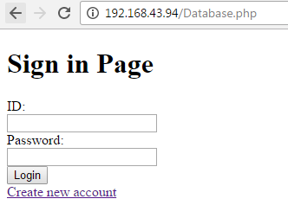
Sign in Page:
<!DOCTYPE html>
<html>
<body>
<h1>Sign in Page </h1>
<form method="POST" action="abcde.php">
ID:<br>
<input type="text" name="id"><br>
Password:<br>
<input type="text" name="pswd"><br>
<input type="submit" value="Login"><br>
<a href="Log.php">Create new account</a>
</form>
</body>
</html>

Slide 29
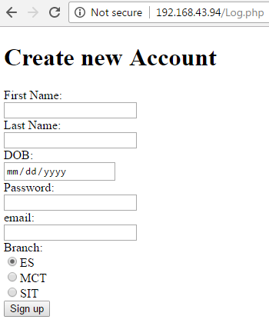
Sign up Page:
<!DOCTYPE html>
<html>
<body>
<h1>Create new Account </h1>
<form method="POST" action="create.php">
First Name:<br>
<input type="text" name="fn"><br>
Last Name:<br>
<input type="text" name="ln"><br>
DOB:<br>
<input type="date" name="dob"><br>
Password:<br>
<input type="password" name="pswd"><br>
email:<br>
<input type="email" name="ema"><br>
Branch:<br>
<input type="Radio" name="br" value="ES" checked>ES<br>
<input type="Radio" name="br" value="MCT">MCT<br>
<input type="Radio" name="br" value="SIT">SIT<br>
<input type="submit" value="Sign up"><br>
</form>
</body></html>

Slide 30
Credentials Verification at SERVER side:
<!DOCTYPE html>
<html>
<body>
<?php
$name=$_POST["id"];
$pswd=$_POST["pswd"];
$conn=new mysqli("localhost","root","123","ashish");
if($conn->connect_error){
echo "error";
}
else{
if($result=$conn->query("select email,pswd from info;")){
if($result->num_rows > 0){
while($row = $result->fetch_assoc()){
$email=$row["email"];
if($name==$email){
echo "id found ";
if($pswd==$row["pswd"]){
header("Location: profile.php?email=$email");
echo "logged in successfully";
}}}}}}?>
</body></html>

Slide 31
<!DOCTYPE html>
<?php
if(isset($_FILES['image'])){
$name=$_GET["email"];
$fname=$_FILES['image']['name'];
$fsize=$_FILES['image']['size'];
$ftmp=$_FILES['image']['tmp_name'];
move_uploaded_file($ftmp,"uploads/".$fname);
echo "success";}
if (is_dir("uploads")){
if ($dh = opendir("uploads")){
while (($file = readdir($dh)) !== false){
$auext=array("wav","WAV","mp3","MP3");
$imext=end(explode(".",$file));
$im=array("jpg","jpeg","png","PNG","JPEG","JPG","GIF","gif");
if(in_array($imext,$im)){
echo "<img src='uploads/$file' width='200' height='200'>";
}
if(in_array($ext,$auext)){
echo "<audio controls> \n<source src='uploads/$file' type='audio/mp3'>
\n <source src='uploads/$file' type='audio/wav'>\n </audio>";
}}
closedir($dh);}}
?>

Slide 32
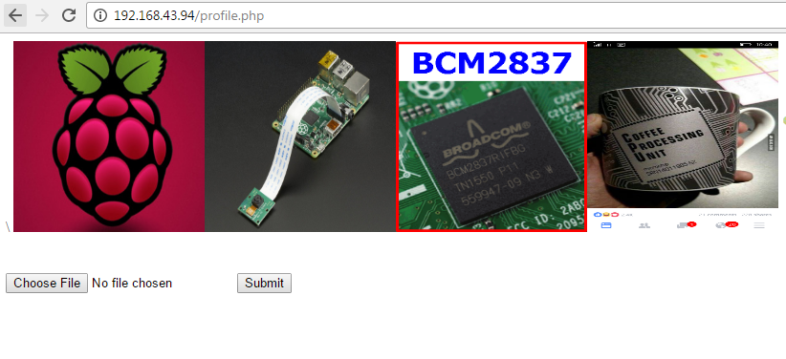
<html>
<body>
<?php
$email=$_GET["email"];
$conn=new mysqli("localhost","root","123","ashish");
if($conn->connect_error){echo "error";}
else{
$res=$conn->query("select * from info");
if($res->num_rows > 0){
while($row=$res->fetch_assoc())
{
if($email==$row["email"]){
echo "<h1>".$row["name"]."</h1>"."<br>";
echo $row["lastname"];
break;
}}}}
?>
<form action="" method="POST" enctype="multipart/form-data">
<input type="file" name="image"/>
<input type="submit"/>
</form>
</body>
</html>

Slide 33
SERVER Based Robot using Android App:

Slide 34
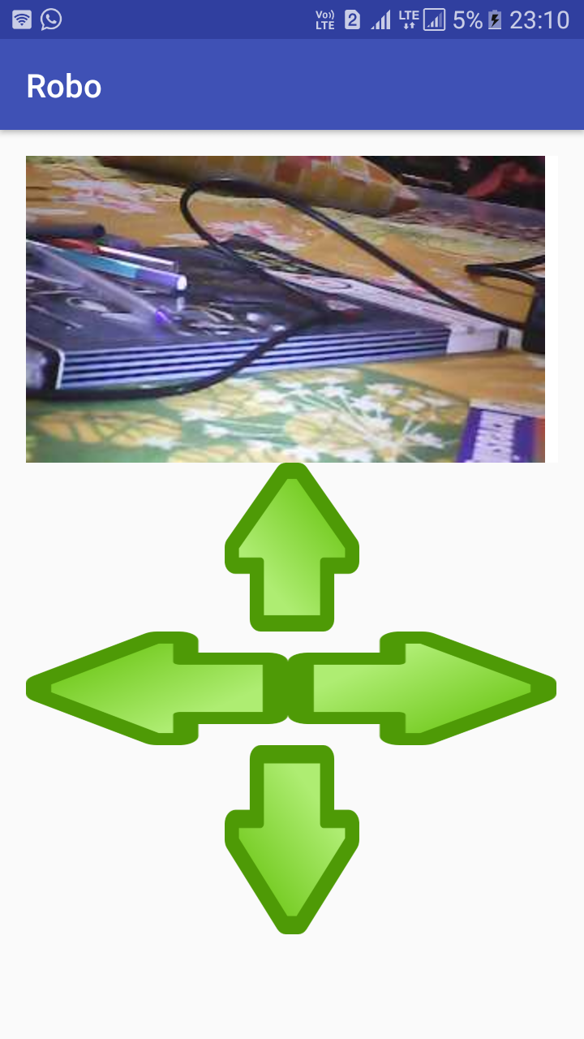
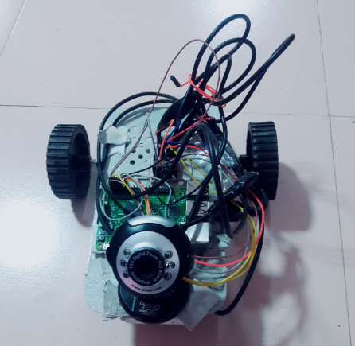
Android App:

Slide 35
Code section:
Forward:
Reverse:
<!DOCTYPE html>
<html>
<body>
<?php
exec("gpio -g mode 4 out");
exec("gpio -g mode 14 out");
exec("gpio -g mode 17 out");
exec("gpio -g mode 18 out");
exec("gpio -g write 4 1");
exec("gpio -g write 14 0");
exec("gpio -g write 17 1");
exec("gpio -g write 18 0");
?>
</body>
</html>
<!DOCTYPE html>
<html>
<body>
<?php
exec("gpio -g mode 4 out");
exec("gpio -g mode 14 out");
exec("gpio -g mode 17 out");
exec("gpio -g mode 18 out");
exec("gpio -g write 4 0");
exec("gpio -g write 14 1");
exec("gpio -g write 17 0");
exec("gpio -g write 18 1");
?>
</body>
</html>

Slide 36
Right:
Left:
<!DOCTYPE html>
<html>
<body>
<?php
exec("gpio -g mode 4 out");
exec("gpio -g mode 14 out");
exec("gpio -g mode 17 out");
exec("gpio -g mode 18 out");
exec("gpio -g write 4 1");
exec("gpio -g write 14 0");
exec("gpio -g write 17 0");
exec("gpio -g write 18 1");
?>
</body>
</html>
<!DOCTYPE html>
<html>
<body>
<?php
exec("gpio -g mode 4 out");
exec("gpio -g mode 14 out");
exec("gpio -g mode 17 out");
exec("gpio -g mode 18 out");
exec("gpio -g write 4 0");
exec("gpio -g write 14 1");
exec("gpio -g write 17 1");
exec("gpio -g write 18 0");
?>
</body>
</html>

Slide 37
Conclusion:
The Raspberry Pi is a powerful little beast and a great platform for building low-cost, but highly capable, embedded systems. The interfaces built into its GPIO connector make it easy to bolt on modules using simple low-cost electronics and a bit of configuration to create very functional and flexible systems. The inclusion of a dedicated camera interface and networking interfaces give you everything.

Slide 38
Query session
?

Slide 39
Thank You

Slide 40
Sudo nano /var/www/html
Run above command on putty or raspbian terminal to access html folder to save ur html php files

